Slide 1
Cancer Research Data Analysis
Presented by:
Zackery Rogers,
Luis Rojas,
Hector Ladero, Akanksha Kukhraniya, Mariam Ahmad

Slide 2
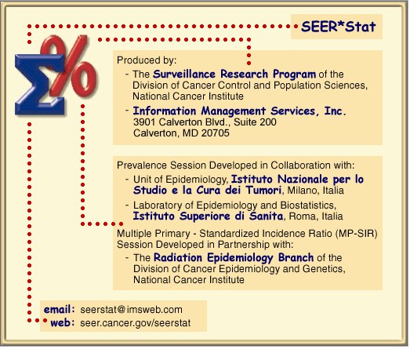
CDC SEER Data

Slide 3
SEER Software

Slide 7
